Slide 1
Boosting Methods
Y.LAKSHMI PRASAD
08978784848

Slide 2
Boosting
→ Boosting is a sequential process, where each subsequent model attempts to correct the errors of the previous model.
→ The succeeding models are dependent on the previous model.
→ Boosting gives misclassified samples higher preference/weight.
→ It is a method to “boost” weak learning algorithm (“single tree”) into strong learning algorithm.

Slide 3
How Boosting Works
Let’s understand the way boosting works in the steps:
1. A subset is created from the original dataset.
2. Initially, all data points are given equal weights & a base model is created on this subset.
3. This model is used to make predictions on the whole dataset.
4. Errors are calculated using actual values & predicted values.
5. The observations which are incorrectly predicted, given higher weights.

Slide 4
How Boosting Works
6. Another model is created & predictions are made on the dataset.
7. The model tries to correct the error from the previous dataset.
8. Similarly, multiple models are created to reduce the errors of the previous model.
9. The final model is the weighted mean of all models.

Slide 5
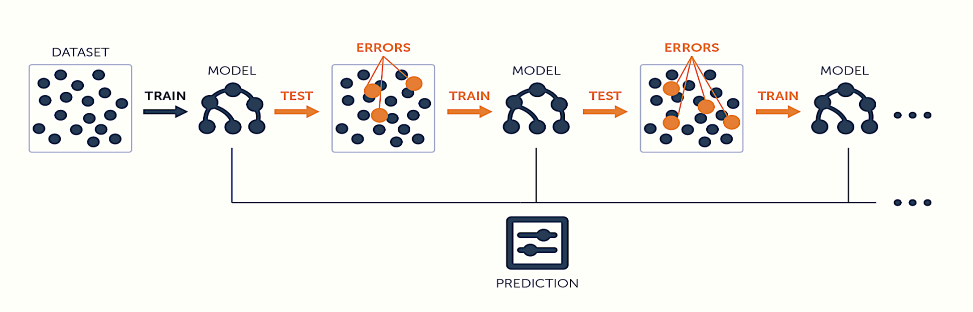
What is Boosting
Image Source: Google

Slide 6
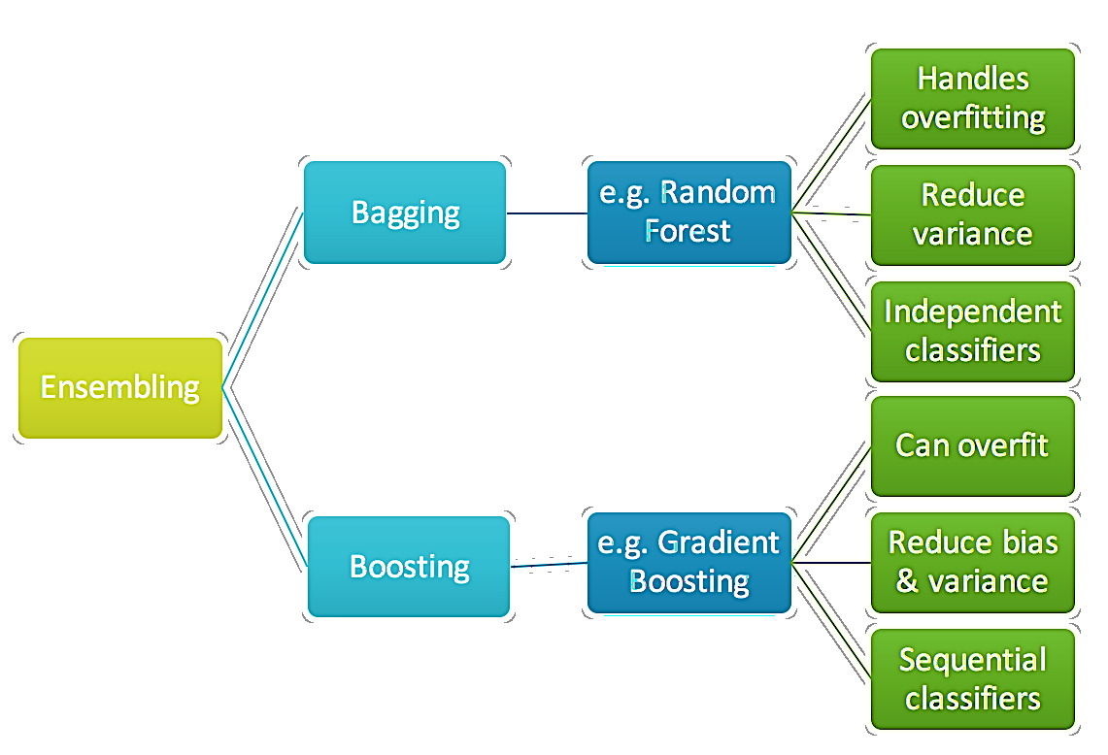
Bagging Vs Boosting

Slide 7
Difference between Bagging & Boosting
Bagging
Boosting
In bagging, Individual Trees are Independent of each others & is a method of improving performance by aggregating result of weak learners.
In boosting, Individual Trees are Not Independent of each other because the trees correct the result of previous trees.
Training stage is parallel in Bagging. This means that each model is built independently.
Training stage is sequential in Boosting. This means weights are assigned to the data.
The purpose of Bagging is to reduce Variance. It may solve the problem of Over-fitting
The purpose of Boosting is to reduce Bias. It may increase the overfitting in the data.

Slide 8
Boosting
1. Boosting, boosts the performance of weak learners to attain performance of stronger learner.
2. Similar to bagging, it uses ensemble of models trained on resample data and a vote to determine the final prediction
3. It combines models of the same type
4. Explicitly seeks modes that complement one another. i.e. where one model fails, the subsequent one pitches in
5.It is an iterative method i.e. the models are created in a sequence. Not in parallel as in bagging.

Slide 9
Boosting
6. Each new model is influenced by performance of the previous model performance.
7. It encourages new models to become experts for instances handled incorrectly by earlier one by assigning greater weight to those erroneous instances

Slide 10
Boosting
8. Boosting also assigns weights to the various model instances based on the instances contribution to ensemble.
9. Since the models in the ensemble are built to be complimentary, it is possible to increase ensemble performance to an arbitrarily very high number by adding more and more predictors (may lead to overfitting).

Slide 11
AdaBoost (Adaptive Boosting)
AdaBoost works on improving the areas where the base learner fails.
The base learner is a machine learning algorithm which is a weak learner and upon which the boosting method is applied to turn it into a strong learner.
Any machine learning algorithm that accept weights on training data can be used as a base learner.

Slide 12
Ada-Boost
1. Used for classification where every instance is given a non zero weight.
2. Beginning with un-weighted (equal weight) data, the first classifier attempts to model the outcome
3. Observations which the classifier predicted correctly, will be less likely to appear in the training set for the following classifier, conversely, the difficult to classify examples will appear more frequently.

Slide 13
Ada-Boost
4. The subsequent rounds of weak learners are trained on difficult to classify data
5. The process continues until desired level of accuracy threshold is achieved
6.Though boosting can be used for any type of classifier, it is mostly used for decision tree.

Slide 14
Ada-Boosting mechanics
1. The adaboost_M1 begins by assigning equal weights to all data points
2.It builds the first learner and re-weights each instance based on the classifier output. i.e., Weights of correctly classified records are decreased and Weights of incorrectly identified ones are increased.
3. This produces a set of “easy” instances with low weights and a set of “hard” ones with high weights.

Slide 15
Ada-Boosting mechanics
4. In the subsequent iteration, a classifier is built for the re-weighted data that focuses on classifying the hard instances correctly.
4(a). As a result of reweighting, some hard instances may become harder, some hard instances can become easier and some easier instances may become harder
4(b). How much should the weight change? Depends upon current classifier’s overall error.

Slide 16
Ada-Boosting mechanics
5. After all the weights have been updated for correctly classified records, they are re-normalized so that the sum of weights remain same as before.
6. Classifiers that perform well on the weighted training data from where it was built, receives highest weight.
7. Boosting give more accurate results than bagging but at the risk of over-fitting.

Slide 17
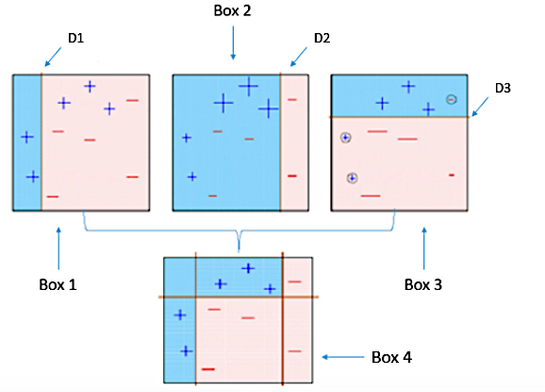
ADABoost

Slide 18
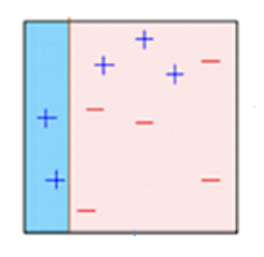
ADABoost
Box 1: You can see that we have assigned equal weights to each data point and applied a decisioning to classify them as + (plus) or – .
The Decisioning (D1) has generated vertical line at left side to classify the data points.
We see that, this vertical line has incorrectly predicted three + (plus) as – (minus). In such case, we’ll assign higher weights to these three + (plus) and apply another decisioning layer.

Slide 19
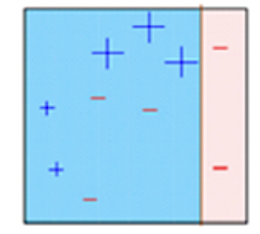
ADABoost
Box 2: Here, you can see that the size of three incorrectly predicted + (plus) is bigger as compared to rest of the data points.
In this case, the second decisioning model (D2) will try to predict them correctly.
Now, a vertical line (D2) at right side of this box has classified three mis-classified + (plus) correctly.
But again, it has caused mis-classification errors. This time with three -(minus). Again, we will assign higher weight to three – (minus) and apply another decision layer.

Slide 20
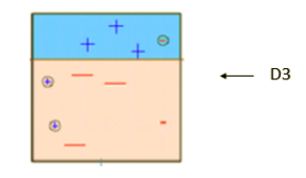
ADABoost
Box 3: Here, three – (minus) are given higher weights.
A decision layer (D3) is applied to predict these mis-classified observation correctly.
This time a horizontal line is generated to classify + (plus) and – (minus) based on higher weight of mis-classified observation.

Slide 21
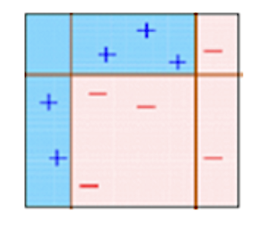
ADABoost
Box4: Here we have combined D1, D2 and D3 layers to form a strong prediction having complex rule as compared to individual weak learner.
Thus, this algorithm classified these observations quite well as compared to any weak individual learner.

Slide 22
Ada Boost Hyperparameters
base_estimator : object, optional (default=None) The base estimator from which the boosted ensemble is built. Support for sample weighting is required, as well as proper classes_ and n_classes_ attributes. If None, then the base estimator is DecisionTreeClassifier(max_depth=1).
n_estimators : integer, optional (default=50) The maximum number of estimators at which boosting is terminated. In case of perfect fit, the learning procedure is stopped early.
learning_rate : float, optional (default=1.) Learning rate . shrinks the contribution of each classifier by learning_rate. There is a trade-off between learning_rate and n_estimators.

Slide 23
Ada Boost Hyper-parameters
algorithm : {‘SAMME’, ‘SAMME.R’}, optional (default=’SAMME.R’)If ‘SAMME.R’ then use the SAMME.R real boosting algorithm. base_estimator must support calculation of class probabilities. If ‘SAMME’ then use the SAMME discrete boosting algorithm. The SAMME.R algorithm typically converges faster than SAMME, achieving a lower test error with fewer boosting iterations.
random_state : int, RandomState instance or None, optional (default=None)If int, random_state is the seed used by the random number generator; If RandomState instance, random_state is the random number generator; If None, the random number generator is the RandomState instance used by np.random.

Slide 24
SAMME vs SAMME.R
SAMME: Stagewise Additive Modeling using a Multi-class Exponential loss function.
SAMME.R: Stagewise Additive Modeling using a Multi-class Exponential loss function-Real.
SAMME.R uses the probability estimates to update the additive model, while SAMME uses the classifications only. As the example illustrates, the SAMME.R algorithm typically converges faster than SAMME, achieving a lower test error with fewer boosting iterations.

Slide 25
Adaboost Vs Gradient Boost
At each iteration, adaptive boosting changes the sample distribution by modifying the weights attached to each of the instances. It increases the weights of the wrongly predicted instances and decreases the ones of the correctly predicted instances. The weak learner thus focuses more on the difficult instances. After being trained, the weak learner is added to the strong one according to his performance (so-called alpha weight). The higher it performs, the more it contributes to the strong learner.

Slide 26
Adaboost Vs Gradient Boost
Gradient boosting doesn’t modify the sample distribution.
Instead of training on a newly sample distribution, the weak learner trains on the remaining errors (so-called pseudo-residuals) of the strong learner.
It is another way to give more importance to the difficult instances.
At each iteration, the pseudo-residuals are computed and a weak learner is fitted to these pseudo-residuals.

Slide 27
Adaboost Vs Gradient Boost
Then, the contribution of the weak learner (so-called multiplier) to the strong one isn’t computed according to his performance on the newly distribution sample but using a gradient descent optimization process.
The computed contribution is the one minimizing the overall error of the strong learner.

Slide 28
Gradient Boosting
The intuition behind gradient boosting algorithm is to repetitively leverage the patterns in residuals and strengthen a model with weak predictions and make it better.
Once we reach a stage that residuals do not have any pattern that could be modelled, we can stop modelling residuals (otherwise it might lead to over-fitting).
Algorithmically, we are minimizing our loss function, such that test loss reach its minima.

Slide 29
Gradient Boosting
1. Fit a simple linear regressor or decision tree on data (I have chosen decision tree in my code) [call x as input and y as output].
2. Calculate error residuals. Actual target value, minus predicted target value [e1= y - y_predicted1 ]
3. Fit a new model on error residuals as target variable with same input variables [call it e1_predicted]

Slide 30
Gradient Boosting
4. Add the predicted residuals to the previous predictions [y_predicted2 = y_predicted1 + e1_predicted]
5. Fit another model on residuals that is still left. i.e. [e2 = y - y_predicted2]and repeat steps 2 to 5 until it starts overfitting or the sum of residuals become constant. Overfitting can be controlled by consistently checking accuracy on validation data.

Slide 31
Gradient Boosting:
1.Idea is to build a simple model say
… y = f1(x) + e1
2.Next iteration builds a model to predict e1 i.e. Y = f1(x) + f2(x) + e2. This f2 in this iteration leaves it’s own residuals
3.Next iteration builds a model to predict e2. Y = f1(x) + f2(x) + f3(x) + e3….
4.We can keep adding models to predict the residuals

Slide 32
Gradient Boosting:
5.Thus gradient boosting yields additive ensemble models
6.By fitting new models to the residuals, the overall learner gradually improves in areas where residuals are initially high
7.To prevent over-fitting, the effect of subsequent models have to be dampened by introducing a concept of step towards minimising the residuals

Slide 33
Gradient Boosting
Advantages :
1.One of the most accurate ensemble methods. Generally superior to Random Forest when well trained
Disadvantage:
1.Difficult to interpret
2.Prone to overfit

Slide 34
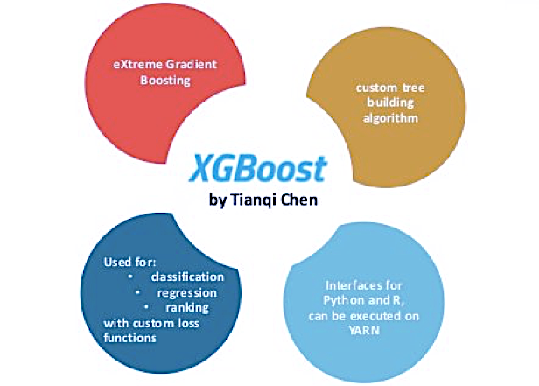
XGBOOST
XGBoost (Extreme Gradient Boosting) is an optimized distributed gradient boosting library.
It uses gradient boosting (GBM) framework at core. Yet, does better than GBM framework alone.
Serves the purpose of Generalization and Reduction in Error
Its faster because it was written in C++.
XG internally has parameters for cross-validation, regularization, missing values, tree parameters etc.

Slide 35
XGBoost Advantage
Regularization: Standard GBM implementation has no regularization like XGBoost, therefore it helps to reduce overfitting. In fact, XGBoost is also known as ‘regularized boosting‘ technique.
Faster Processing: XGBoost implements parallel processing and is blazingly faster as compared to GBM.

Slide 36
XGBoost Advantage
Missing Values: XGBoost has an in-built routine to handle missing values. XGBoost tries different things as it encounters a missing value on each node and learns which path to take for missing values in future.
Tree Pruning: XGBoost on the other hand make splits up to the max depth specified and then start pruning tree backwards and remove splits beyond which there is no positive gain.

Slide 37
XGBoost Advantage
Built In Cross-Validation XGBoost allows user to run a cross-validation at each iteration of the boosting process and thus it is easy to get the exact optimum number of boosting iterations in a single run.

Slide 38
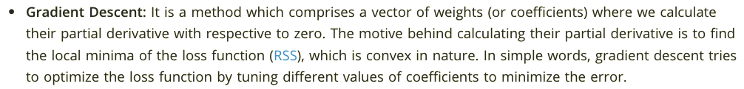
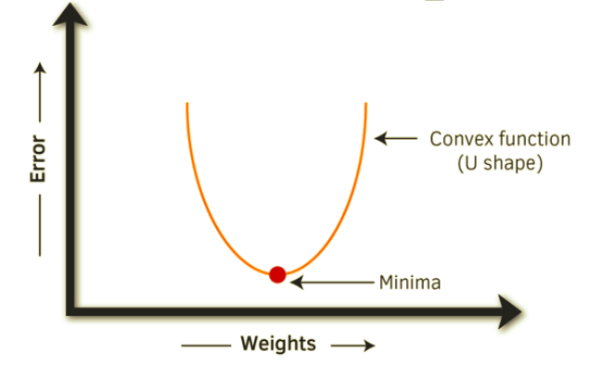
XGBoost Advantage

Slide 39
Any Questions?
THANK YOU

